Slide 1
Accelerating Convergence using Multigrid method
25th November 2015
Hemaditya Malla
Sanath Keshav
R S Siddharth

Slide 2
What is Multigrid method?
A group of algorithms for solving partial differential equations using hierarchy of discretizations.
They are an example of a class of techniques called multiresolution methods.
For example, many basic relaxation methods exhibit different rates of convergence for short- and long-wavelength components, suggesting these different scales be treated differently.
Idea is to accelerate the convergence of a basic iterative method by global correction from time to time, accomplished by solving a coarse problem.

Slide 3
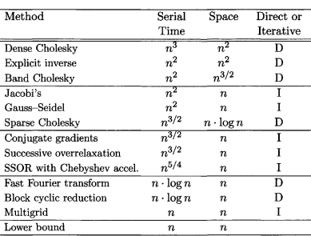
What is Multigrid method?
PS: Multigrid is the fastest!! :P

Slide 4
Basic Algorithm
Smoothing
Reducing high frequency errors, for example using a few iterations of the Gauss–Seidel method.
Restriction
Down sampling the residual error to a coarser grid.
Interpolation
Interpolating a correction computed on a coarser grid into a finer grid.

Slide 5
Why Multigrid method?
The Jacobi and Gauss-Seidel iterations produce smooth errors.
The error vector e has its high frequencies nearly removed in a few iterations. But low frequencies are reduced very slowly. Convergence requires order of N^2 iterations—which can be unacceptable.
The extremely effective multigrid idea is to change to a coarser grid, on which “smooth becomes rough” and low frequencies act like higher frequencies.

Slide 6
Smoothening property of Gauss Seidel Method
Gauss Seidel method damps out the high frequency component of error very quickly.
It damps out low frequency component very slowly.
Hence, by coarsening the mesh the low frequency component becomes the high frequency component thereby damping it out very quickly.
As the error becomes smoother and smoother we need lesser number of divisions to efficiently model the system.

Slide 7
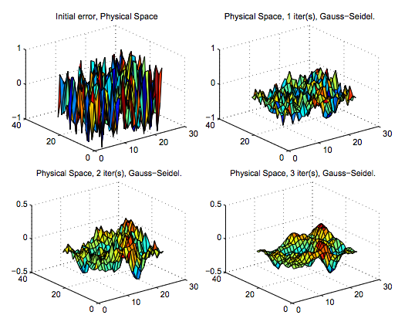
Smoothening property of Gauss Seidel Method

Slide 8
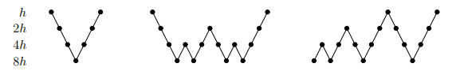
Types of cycles

Slide 9

Problem
$−∆ u=f\left(x,y\right) in Ω=\left(0,1\right)×\left(0,1\right)$
$Exact solution is u\left(x,y\right)=e^{xy}$
$Forcing function f\left(x,y\right)=−\left(x^{2}+y^{2}\right)e^{xy}$
$\frac{∂^{2}u}{∂x^{2}}+\frac{∂^{2}u}{∂y^{2}}=−f$
$Boundary conditions$
$u\left(x,0\right)=1$
$u\left(x,1\right)=e^{x}$
$u\left(0,y\right)=1$
$u\left(1,y\right)=e^y$

Slide 10
Thank You!!

